Slide 1



PROJECT ALPHA
Muhammad Qamar
Umer Munir
Shingirai Rice
Muhammad Khan
Waleed Hassan
Abdulkhaliq Ajibola Olatunji
Notes:
My name is muhammad qamar, and I am the leader of project alpha

Slide 2

The Team
Umer Munir – Coder
Lead the development team in designing project
Gave out tasks and assisted well
Muhammad Khan -Coder/Designer
Helped design the website
Designed the sketches
Waleed Hassan – Researcher
Did research for the website to see what could be added
Found universities with positive reviews
Muhammad Qamar - Team Leader
Created and set task for each member of the teams
Communicate with the team to ensure that they were up to date with the project
Tracking all the progress
Shingirai Rice – Designer
Helped with designing the diagrams
Managed the report
Abdulkhaliq Ajibola Olatunji – Researcher
Research on competitors
Found reviews and saw what could be improved
Notes:
This is the project alphas team as you can see we all have assigned roles within our team with me being leader which is where I create ….
My other teammates rice the designer helped with …
Olatunji who is the researcher helped by doin research on… and found …
The team on the right are the development team who designed the main website
Umer whos role is the coder dedicated himself to making the best website for students took the main lead to designing the website
He was assisted by two of the other members who are Muhammad khan and waleed hassan
Muhammad Khans role was to be a coder and the designer where he assisted help in creating the website and he designed some of the sketches for the website which will be shown on the next slide
And Waleed Hassan who did research.. And found universities

Slide 3



How we managed our workload
What software we used
Microsoft Teams for meetings and discussions
Microdot Office 365 to share our work
WhatsApp for communication via mobile
Notes:
We used Ms teams for our meetings and discussions and we had set dates which were discussed prior so that we can meet up and discuss what we needed to do by the end of our set deadline
We used Office 365 to share our documents
We used whatsapp for mobile communication as it was easier to contact one another by using our phones

Slide 4



What's our IDEA?
Who's it aimed at?
Notes:
Muhammad
Whats our IDEA? Our Project idea is to design a website which consists of helping new university students find accommodation in the UK. These include people from outside the uk who are coming to study in the uk
How it works and our research into this We noticed that coming to University is hard as you must leave everything behind including family and friends, and our purpose is to help them find their right accommodation and help them get situated finding their right accommodations and right friends.
Whos it aimed at Our Project is solely aim at new university students to make their lives easier so that they don’t have to go through the struggle of finding good and affordable accommodation
What kind of features will the website have The website will offer a chat feature where you can chat to others looking to rent the same accommodation,\ it will also have ratings on the accommodation from previous students that have rented the flat out. The website also provides excellent feedback on what the accommodations provide such as WI-FI, one or two bedrooms or more etc. The reason we have selected this idea is that it's hard for students to find a place to live as they may be from abroad or they may not have the funds, we have decided to take action to help those new starters find a new home and new friends at their preferred university

Slide 5
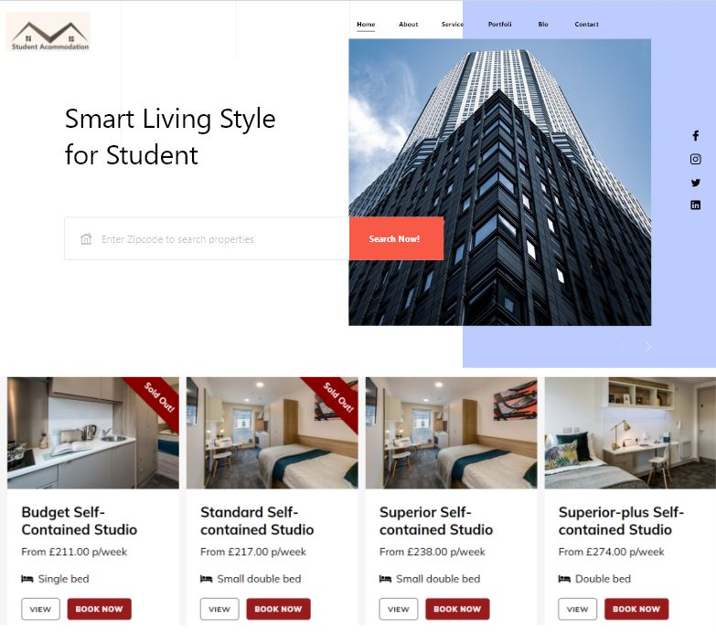
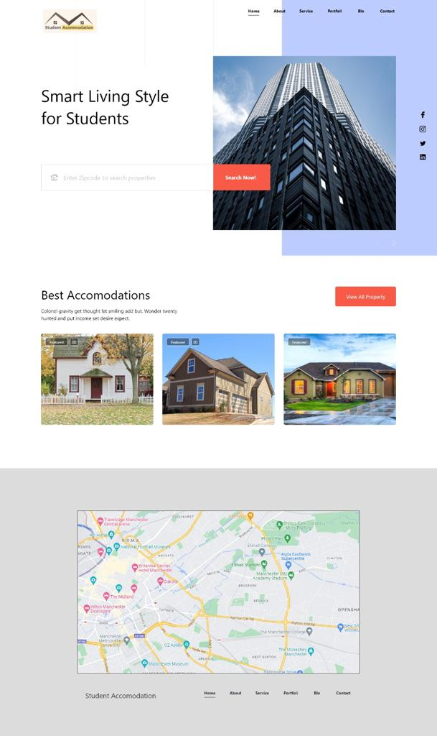

Preliminary Designs/Sketches
Notes:
Theses are some of the sketches that Muhammad khan designed as you can see, there are two similar designs he had in mind, the style is more or less the same and it has some cool features such as a search bar and it had a nice implementation of the navigation bar followed by socials which we may implement later
We have also decided to implement a map feature where you can find different university locations, this could also serve some other purposes such as stores for students’, restaurants and more

Slide 6



Development & Implementations
University of Huddersfield’s Selene Server
Visual Studios Code
Database

Slide 7
What our website will have
The Home page will give students an overview of the services the website will offer.
A navigation bar will be included on all pages. This is a user-friendly feature that will allow students to easily navigate around the website.
A page consisting of a map that the students can interact with to find the accommodation that’s right for them.
Our service logo will be visible on every page on our website.
A page consisting of the top recommended accommodation for each location. This will include detailed interactive images of the accommodation, and a section with all the student reviews and ratings.
About us page including details about the service, personnel and contact information
Search engine that allows students to navigate through each locations and acquire details about the accommodations.

Slide 8
How it was built
What the developers implemented
Database to store information
Google API
Contact Page
Add your own rental property where the site will take in the information from the user
Dev Team
Umer Munir – Coder
Lead the development team in designing project
Gave out tasks and assisted well
Muhammad Khan -Coder/Designer
Helped design the website
Designed the sketches
Waleed Hassan – Researcher
Did research for the website to see what could be added
Found universities with positive reviews
Notes:
How it was built ?
They used a database to store the customers information such as login details and their personal details
They used a google API to implement the map feature so that a locations can be viewed via the map
Contact page to contact the developers or the landlords advertising
Add your own rental property where the site will take in the information from the user

Slide 9
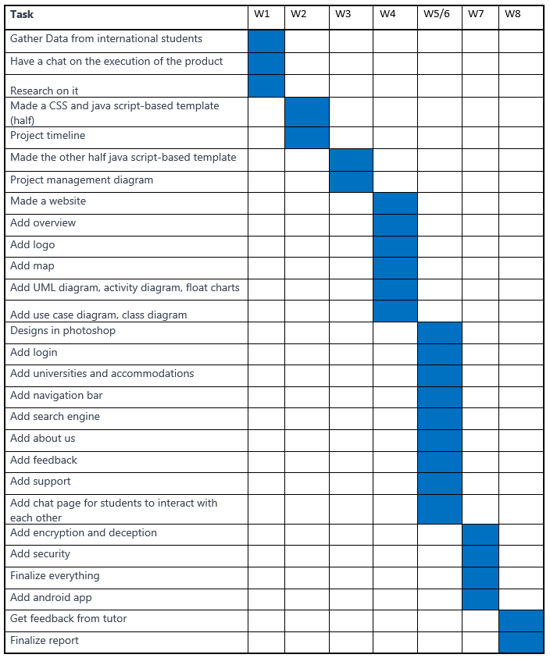
Project Schedule.
Notes:
This is our ganttchart we shows our project schefule

Slide 10
Conclusion
What's our goal
Provide Positive experience
User-friendly site
Other additional services
Notes:
We wanted to create a site where new students can come to the UK and settle in peace without having to find and worry about accommodations

Slide 11
Thank you for listening The Development team will now show the demo?

